Slide 1
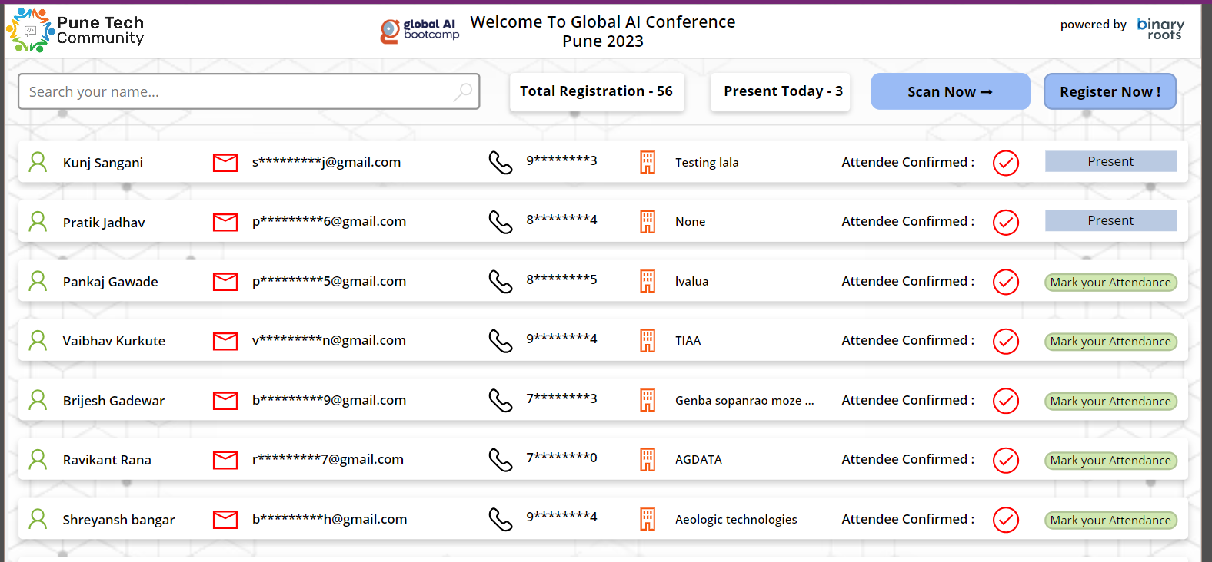
Community Event
Registration Desk App
Siddharth Vaghasia (@siddh_me)

Slide 2





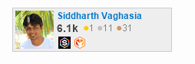





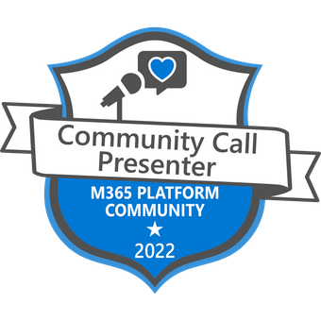
Siddharth Vaghasia
Microsoft 365 | Founder | BinaryRoots
SharePoint, Teams App, Power Platform, Azure, .NET
https://siddharthvaghasia.com
https://c-sharpcorner.com/members/siddharth-vaghasia
@siddh_me
siddharth-vaghasia
https://www.linkedin.com/in/siddharthvaghasia

Slide 3
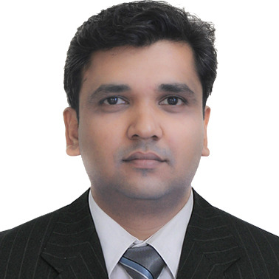
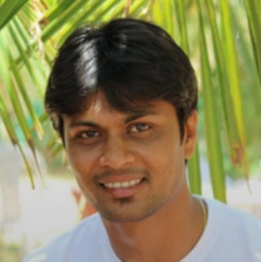

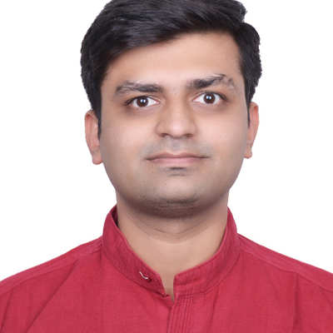

Pune Tech Community Organizers
https://meetup.com/pune-tech-community/

Slide 4

Grateful for the vibrant Microsoft 365 and Power Platform Community
where innovation thrives, collaboration soars, and excellence is celebrated!

Slide 5

Idea & Driving factors
Use of Technology for Technical Events
API
Pune Tech Community – Frequent organizers of Online and Virtual events
Handy Attendees Information
Keeping Attendees Count on day of event
Streamlining Registration Process
Explore Open AI and Prompt Engineering
Enabling ChatGPT to deliver customized daily insights to individual users
Calling External APIs from ACEs.

Slide 6
Summary
Simple and user-friendly interface for event organizers to easily register attendees.
Streamlined process for marking attendee presence at events.
Powerful search functionality enabling organizers to quickly find and manage attendee information.
Ability to scan QR codes for swift attendee identification and instant check-in.
Developed with the community in mind, catering to the specific needs of event organizers and attendees.
Flexibility to customize registration fields based on event requirements

Slide 7




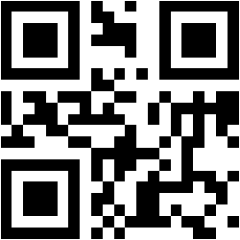
Solution
https://goqr.me/api/doc/
QR Code Generator

Slide 8
Links to Download
https://github.com/siddharth-vaghasia/public-docs/blob/master/powerapps/components/GlobalAIConferencePune2023_1_0_0_1.zip
https://github.com/siddharth-vaghasia/public-docs/blob/master/powerapps/components/Event%20List%20template.pnp

Slide 9
Demo/ Code Walkthrough

Slide 10
THANK YOU

